Slide 1
Disability-Related Training for Managers and Supervisors
Office of Administration
Bureau of Equal Employment Opportunity
2017
Notes:
Welcome to Disability-Related Training for Managers and Supervisors. This training is intended as a broad overview of the protections against disability discrimination afforded to all employees and the obligations that the commonwealth has as an employer to ensure equal employment opportunity for individuals with disabilities.

Slide 2
Objectives
Provide an overview of commonwealth policies which prohibit discrimination against individuals with disabilities
Executive Order 2002-5, Disability-Related Policy
Management Directive 205.25, Disability-Related Employment Policy
Executive Order 2016-04, Equal Employment Opportunity
Management Directive 410.10, Guidelines for Investigating and Resolving Internal Discrimination Complaints
Review MD 205.25 which defines disability under commonwealth policy
Americans with Disabilities Act (ADA)
Pennsylvania Human Relations Act (PHRA)
Outlines processes for reasonable accommodations
Examine MD 410.10, the commonwealth’s policy regarding investigating and resolving internal complaints
Explain the role of managers and supervisors in ensuring equal employment opportunity
Notes:
Let’s begin by going over the objectives of this training. First, we will provide an overview of commonwealth policies which prohibit discrimination against individuals with disabilities. These policies include: Executive Order 2002-5, Disability-Related Policy, Management Directive 205.25, Disability-Related Employment Policy, Executive Order 2016-04, Equal Employment Opportunity and Management Directive 410.10, Guidelines for Investigating and Resolving Internal Discrimination Complaints.
Second, we will review important components of Management Directive 205.25, Disability-Related Employment Policy. This policy defines “disability” for the purposes of commonwealth workplaces which is similar to the definition found in federal and state laws such as the Americans with Disabilities Act (ADA) and the Pennsylvania Human Relations Act (PHRA). The policy also outlines the processes for requesting and providing reasonable accommodations for a disability.
We will also examine the commonwealth’s policy regarding investigating and resolving internal complaints of discrimination based on disability pursuant to Management Directive 410.10, including an employee’s right to file an internal complaint.
Finally, we will explain the role of managers and supervisors in ensuring equal employment opportunity for all employees.

Slide 3
Why is this important?
Notes:
Why is this topic important? As one of the largest employers in Pennsylvania, the commonwealth is committed to complying with laws and policies which ensure inclusion and equal employment opportunity for all employees, including those with disabilities. By leveraging the talents and abilities of all employees, we can provide the best public service to the citizens we serve.
There are a large number of Pennsylvanians who have a disability. Nearly 21%, or 1.5 million people between the ages of 21 and 64, have a disability. This is equivalent to a city the size of Philadelphia.
As a management employee, you are responsible for compliance with our policies.
Let’s move on and review the commonwealth polices which prohibit discrimination against individuals with disabilities.

Slide 4
Commonwealth Policy
Executive Order 2002-5
Disability-Related Policy
Management Directive 205.25
Disability-Related Employment Policy
Executive Order 2016-04
Equal Employment Opportunity
Management Directive 410.10
Guidelines for Investigating and Resolving Internal Discrimination Complaints
Notes:
The first policy we’ll discuss is Executive Order 2002-5, Disability-Related Policy, ensures equal employment opportunity to individuals with disabilities. Under this Executive Order, individuals with disabilities are to be treated with respect and dignity and provided access to all commonwealth services, programs, activities, and employment opportunities.
Management Directive 205.25, Disability-Related Employment Policy, assures equal employment opportunities for qualified applicants and employees with disabilities in all agencies under the Governor’s jurisdiction. The directive also provides guidance and procedures for implementing the Governor’s initiatives on employing individuals with disabilities and discusses the processes related to requests for reasonable accommodations, which will be discussed in more detail later in this training.
Executive Order 2016-04, Equal Employment Opportunity, establishes commonwealth policy prohibiting discrimination based on numerous protected classes, including disability. Finally, Management Directive 410.10, Guidelines for Investigating and Resolving Internal Discrimination Complaints outlines the processes for filing, investigating and resolving internal discrimination complaints.
It should be noted that commonwealth policy is written to comply with federal and state laws, including the Americans with Disabilities Act and the Pennsylvania Human Relations Act, which also protect individuals with disabilities from discrimination.

Slide 5
Overview of the ADA
Passed in 1990, amended in 2009
Title I – non-discrimination in employment
Enables individuals with disabilities to enjoy the same terms, conditions and benefits of employment as individuals without disabilities in all aspects of employment
Notes:
Before we review how disability is defined under MD 205.25, lets review the federal and state laws which make discrimination against an individual with a disability illegal.
The Americans with Disabilities Act or ADA was signed into law in 1990 and is the primary federal law prohibiting discrimination based on disability. The ADA was amended in 2009. The amendment broadened the ADA’s protections, including those in Title I of the act which cover non-discrimination in employment. The intent of Title I of the ADA is to enable individuals with disabilities to enjoy the same terms, conditions, and benefits as individuals without disabilities in all aspects of employment.

Slide 6
Further Protection from Discrimination
In addition to the ADA, other statutes prohibit discrimination on the basis of disability:
Section 504 of the Rehabilitation Act of 1973
Genetic Information Non-Discrimination Act (GINA)
Pennsylvania Human Relations Act (PHRA)
Notes:
In addition to the ADA, there are other federal and state laws that also prohibit discrimination on the basis of disability:
Section 504 of the Rehabilitation Act of 1973 is a federal law which prohibits any program or activity receiving federal financial assistance from excluding participation in, denying benefits to or discriminating against any qualified individual, solely based on his/her disability.
Genetic Information Non-Discrimination Act is a federal law which forbids discrimination on the basis of genetic information in employment. Genetic information includes information about an individual’s genetic tests and the genetic tests of an individual’s family members, as well as information about the manifestation of a disease or disorder in an individual’s family members (i.e. family medical history). Family medical history is included in the definition of genetic information because it is often used to determine whether someone has an increased risk of getting a disease, disorder, or condition in the future.
Pennsylvania Human Relations Act (PHRA) is the state law that prohibits discrimination in employment and public accommodations.

Slide 7
Protections
Application
Hiring
Promotion
Testing
Medical examinations
Layoff/recall
Assignments
Evaluation
Compensation
Discipline
Leave
Training
Benefits
Termination
Notes:
These laws and policies extend protections to all employment practices and procedures including, but not limited to: application, hiring, promotion, testing, medical examinations, layoff/recall, assignments, evaluation, compensation, discipline, leave, training, benefits, termination, and all other aspects of employment.
Now that we reviewed the federal and state laws, let’s go back and learn how disability is defined and who is covered under commonwealth policy.

Slide 8
Disability Defined Under MD 205.25
Disability – A physical or mental impairment that substantially limits one or more major life activities
An individual is covered under MD 205.25 if he/she:
Has a disability;
Has a record of a disability; or
Is regarded as having a disability
Notes:
Under MD 205.25, a disability is defined as a physical or mental impairment that substantially limits one or more major life activities. In the following slides we’ll discuss what is meant by a physical or mental impairment, we’ll review the term “substantially limits” and we’ll also identify what is included in major life activities.
An individual is covered under this management directive if he/she has a disability, a record of a disability, or is regarded as having a disability. During this training we will primarily cover the first prong of the definition but let’s briefly review the other prongs in the next two slides.

Slide 9
“Record of” a Disability
“Record of” applies in situations where an individual has recovered from a condition that meets the definition of disability under the policy.
Example: cancer
There is no requirement to accommodate
Individuals who have a “record of” a disability are entitled to protection from discrimination
Notes:
Record of a disability applies when an employee had a physical or mental impairment which substantially limited a major life activity from which he/she recovered. For example, if someone had cancer which was successfully treated, that individual has a record of a disability.
There is no requirement to accommodate individuals who have a “record of” a disability. Individuals who have a “record of” a disability are entitled to protection from discrimination under federal and state laws and commonwealth policy. Complaints can be filed based on an individual’s record of a disability.

Slide 10
“Regarded As” Having a Disability
Individual has been subjected to an employment action because of an actual or perceived physical or mental impairment
Whether or not the impairment limits or is perceived to limit a major life activity
There is no requirement to accommodate
Individuals who are “regarded as” having a disability are entitled to protection from discrimination
Notes:
An individual meets the third prong of the definition of disability if he/she can establish that they have been subjected to an employment action because of an actual or perceived physical or mental impairment whether or not the impairment limits or is perceived to limit a major life activity.
Examples: (only if needed to illustrate point.) Assistant manager with prominent facial scaring was passed over for promotion. Qualified applicant-formally patient at a state institution, was misdiagnosed as being psychopathic. Never removed from her records. Employer did not hire on that basis.
Individuals who are “regarded as” having a disability but do not in fact have one, are not entitled to a reasonable accommodation.
Individuals who are “regarded as” having a disability are entitled to protection from discrimination under federal and state laws and commonwealth policy. Complaints can be filed on the basis of being “regarded as” rather than having an actual disability. As a manager or supervisor, be careful of what you say so there is no indication that you regard an employee as having a disability. It is important to focus on an employee’s job performance and behavior. Does the employee’s performance and/or behavior meet acceptable standards?
Avoid unnecessary discussions concerning any employee’s possible or current medical conditions.

Slide 11
Physical or Mental Impairment
Physical: any physiological condition, cosmetic disfigurement, or anatomical loss affecting one or more of the body’s systems, including the five senses; neurological, respiratory, digestive, reproductive, elimination functions, musculoskeletal, cardiovascular, endocrine and lymphatic systems
Mental: any physiological or psychological disorder, such as intellectual disability, organic brain syndrome, emotional or mental illness, and learning disabilities
Notes:
To go back to the definition of disability, let’s review what is meant by a physical or mental impairment. A physical impairment includes any physiological condition, cosmetic disfigurement, or anatomical loss affecting one or more of the body’s systems, including the five senses; neurological, respiratory, digestive, reproductive, elimination functions, musculoskeletal, cardiovascular, endocrine and lymphatic systems.
Mental impairments include any physiological or psychological disorder, such as intellectual disability, organic brain syndrome, emotional or mental illness, and learning disabilities.
Now let’s discuss the term “substantially limits.”

Slide 12
Substantially Limiting
To have an actual covered disability an individual must be (or have been) substantially limited in performing a major life activity as compared to most people in the general population.
“Substantially limits” is construed broadly but determining whether an impairment substantially limits still requires an individualized assessment.
Notes:
Not every impairment will constitute a disability, however, Congress intended that the phrase “substantially limits” should be construed broadly. An impairment need not prevent or severely or significantly limit a major life activity to be considered substantially limiting. When determining whether an impairment “substantially limits” a major life activity an individualized assessment is required. The primary focus of the ADA is to determine whether discrimination occurred; the determination of disability should not require an extensive analysis.
The condition, manner, or duration (where duration refers to the length of time it takes to perform a major life activity or the amount of time the activity can be performed) may be considered if relevant. Assessing the condition, manner, or duration under which a major life activity can be performed may include consideration of the difficulty, effort or time required to perform a major life activity; any pain experienced when performing a major life activity; the length of time a major life activity can be performed; and/or the way an impairment affects the operation of a major bodily function.
We’ve reviewed physical and mental impairments and substantially limiting, now let’s review major life activities.

Slide 13
Major Life Activities
Notes:
A major life activity is any basic function that the average person in the general population can perform with little or no difficulty. Can you name any major life activities? [GET INPUT FROM CLASS.]

Slide 14
Major Life Activities
Major Life Activities include, but are not limited to:
Walking
Speaking
Breathing
Sitting
Hearing
Eating
Sleeping
Learning
Caring for oneself
Performing manual tasks
Seeing
Standing
Lifting
Bending
Reading
Concentrating
Thinking
Communicating
Notes:
It should be noted that this is not an all inclusive list. “Major Life Activities” are basic activities that the average person in the general population can perform with little or no difficulties. In general, Major Life Activities include: (Read List)
A “Major Life Activity” also includes…Quickly move to next slide:

Slide 15
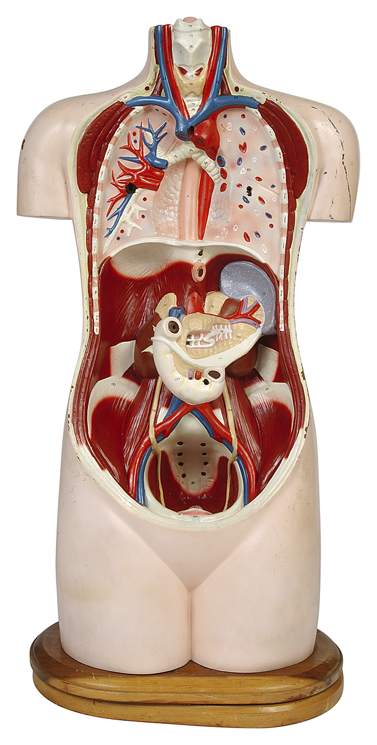
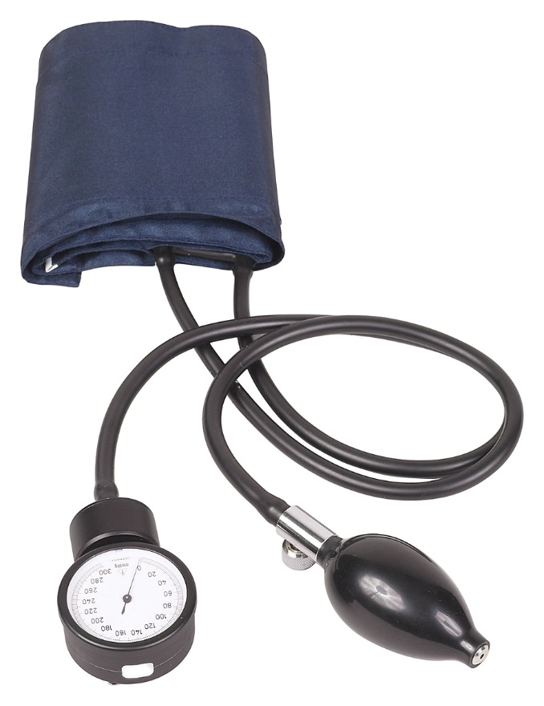
Major Life Activities
Major Life Activities also include the operation of a Major Bodily Function:
Immune system
Normal cell growth
Digestive system
Bowel
Bladder
Neurological system
Brain
Respiratory system
Circulatory system
Endocrine system
Reproductive functions
Notes:
…the operation of a major bodily function, such as the body’s immune, cognitive, digestive, neurological, respiratory, circulatory and endocrine systems, reproductive and elimination functions. As an example, an impairment such as diabetes impairs the function of the body’s endocrine system.
It is important to note that an impairment that affects one of these bodily functions is a disability even if it is episodic or in remission.

Slide 16
Episodic & Conditions in Remission
Conditions that are episodic or in remission are disabilities if they would substantially limit a major life activity when active.
Question: Do you have to provide an accommodation to someone who has a disability but is not currently showing symptoms?
Notes:
An impairment that is episodic or in remission is a disability if it would substantially limit a major life activity when active.
For example, an individual with cancer which is currently in remission is still protected under federal and state laws and commonwealth policy as well as conditions such as asthma and epilepsy.
Let’s examine this question, do you have to provide an accommodation to someone who has a disability but is not currently showing symptoms?
It depends. This can be tricky. For example, if an individual’s asthma is triggered by air pollutants, does it make sense to take away an air filter because they are not currently symptomatic?
We’ve completed reviewing the definition of disability, now we need to discuss another aspect of federal and state laws and policy which is the use of drugs and alcohol.

Slide 17
Drugs and Alcohol
Active use of drugs is not a protected condition under the ADA, PHRA or commonwealth policy.
A person who no longer engages in illegal use of drugs may be a person with a disability if he/she is rehabilitated or is participating in a supervised rehabilitation program.
Alcoholics are protected under the ADA.
An employer may discipline, discharge or deny employment to an alcoholic whose use of alcohol impairs job performance or conduct to the extent that acceptable performance or conduct is not met.
Notes:
An individual who is currently engaging in illegal use of drugs is not a covered entity under the ADA, PHRA, or commonwealth policy.
However, a person who no longer engages in the illegal use of drugs may be an individual with a disability if he/she:
Successfully completed a supervised drug rehabilitation program or has otherwise been rehabilitated, or
Is participating in a supervised rehabilitation program (e.g. Alcoholics Anonymous or Narcotics Anonymous).
An employer may not discriminate against a rehabilitated addict, who is not currently using drugs, based on a history of drug addiction.
On the other hand, active alcoholics are protected under the ADA. However, an employer may discipline, discharge or deny employment to an alcoholic whose use of alcohol impairs job performance or conduct to the extent that he/she is not meeting acceptable performance or behavior standards.
Let’s move on now and discuss reasonable accommodations.

Slide 18
Reasonable Accommodation
Qualified to perform the job
Must perform the essential functions of the job with or without a reasonable accommodation
A reasonable accommodation is a modification or an adjustment to a job and/or work environment which:
enables a person with a disability to perform essential job functions and
to enjoy equal benefits and privileges of employment
Notes:
Like any other employee, an individual with a disability must be qualified to do his/her job. He or she must have the knowledge, skills, and ability to meet the job-related requirements of the position.
An employee must be able to perform the essential functions of the job with or without a reasonable accommodation. A reasonable accommodation is a modification or an adjustment to the job and/or the work environment, which enables the employee with a disability to perform those essential job functions and enjoy equal benefits and privileges of employment as other employees without disabilities.
Let’s look at some examples of reasonable accommodations.

Slide 19
Examples of Reasonable Accommodations
Modifying existing equipment and/or facilities for ease of accessibility
Restructuring the job
Removing, revising or reassigning minor job duties
Modifying work schedules
Reassigning an individual to a vacant position, for which he/she is qualified
Last resort when no other accommodations enable the employee to perform the essential functions of current position
Notes:
As stated, reasonable accommodations help qualified persons with disabilities to perform the essential functions of the job. There are many examples of reasonable accommodations, such as:
Modifying existing equipment or facilities for ease of accessibility. This could include; accessible entrances, ramps, wider aisles, Braille signs, ergonomic workstations, or voice recognition software.
Restructuring the job, which means removing, revising, or reassigning minor duties of the job, not the essential job functions.
Modifying changes to work schedules.
Finally, if no other types of reasonable accommodation enable the employee to perform the essential functions of his/her current position, reassignment to a vacant position for which the employee is qualified may be an option. Reassignment is only considered as a last resort.

Slide 20
What is an Essential Job Function?
Essential Job Functions are the basic, vital, or primary functions of the position
Determining whether a function is essential involves a number of factors, including the employer’s assessment of the need for the particular function
Review MD 205.25, Section 7b, “Job Analysis” and “Pamphlet on Essential Job Functions”
Notes:
We have covered reasonable accommodations and that they are intended to help a qualified applicant or employee perform the essential functions of a position. But what exactly is an essential function? Essential job functions are the basic, vital, or primary functions of the position.
In order to determine what would be an effective accommodation for an individual with a disability, job standards, job descriptions, and essential job functions must be accurate and up to date.
Look at the pamphlet on EJFs. Point out that the pamphlet on EJFs includes simple questions that are helpful when determining if a function is essential. These questions are based on Section 7b of MD 205.25, Job Analysis.

Slide 21
Determining Essential Job Functions
There are several questions that will help you to determine if a job function is ESSENTIAL. Ask yourself:
Does the position exist to perform the function?
Are there a limited number of other employees available to perform the job function?
Is the function highly specialized and does it require special skills?
How much time does the employee spend performing the particular function?
What are the consequences of not requiring a person in this job to perform a particular function?
Notes:
These questions are in the EJF pamphlet and paraphrased from MD 205.25, Section 7b. We recommend keeping the EJF pamphlet as an easy reference tool when reviewing job descriptions and essential job functions.

Slide 22
Determining Essential Job Functions
When determining essential functions, concentrate on what a person does, not how they do it.
Examples of essential functions:
“Travel to and conduct site examinations.” Not-- drive to conduct site examination.
“Input and retrieve data via computer terminal.” Not—manual dexterity to key data into a computer terminal.
Notes:
The main point is that when we as managers and supervisors determine essential functions, concentrate on what a person does, not how they do it.
[READ EXAMPLES]
We have covered essential functions so now we are going to determine when an employer may not have to provide a reasonable accommodation to an employee.

Slide 23
Must Accommodate Unless…
The accommodation would pose an undue hardship for the employer, meaning a significant difficulty or expense
Refers to accommodations that would be unduly extensive, substantial, disruptive
Determined on a case by case basis; unlikely that commonwealth could show cost as an undue hardship
Consider alternative accommodations
Notes:
An employer does not have to provide an accommodation that would pose an undue hardship for the employer. “Undue hardship” means significant difficulty or expense, and focuses on the resources and circumstances of the employer in relationship to the cost or difficulty of providing a specific accommodation. Determinations of undue hardship must be made on a case by case basis. Because of commonwealth resources, it is very difficult for agencies to use cost as a rationale for denying an accommodation request. If a requested accommodation is an undue hardship, alternative accommodations must be considered.

Slide 24
Must Accommodate Unless…
Direct threat – significant risk to the health or safety of the employee or others which cannot be eliminated by modifying policies, practices or procedures or providing auxiliary aids or services
Threat cannot be speculative
Determination based on an assessment of the individual’s present ability to safely perform the essential functions of the job
Assessment must rely on the most current medical or best available objective evidence to determine the nature, duration and severity of the risk
Consideration on whether reasonable modifications of policies, practices or procedures will mitigate the risk
Notes:
Additionally, an employer need not provide an accommodation if it would pose a direct threat, defined as a significant risk to the health or safety of the employee or others which cannot be eliminated by a modification of policies, practices, or procedures, or by the provision of auxiliary aids or services.
A direct threat cannot be speculative. A determination of a direct threat must be based on an individualized assessment of an individual’s present ability to safely perform the essential functions of the job. This assessment must rely on the most current medical or best available objective evidence, to determine the nature, duration and severity of the risk. An employer must also consider whether reasonable modifications of policies, practices, or procedures will mitigate that risk.
Now let’s look at what your role is as a supervisor or manager in this process.

Slide 25
What is Your Role?
Notes:
As a manager or supervisor, you may find yourself asking, “So, what is my role in all of this? Why do I need to know this information?” As a manager or supervisor, your role is crucial. You may participate on job interview panels. You may supervise and evaluate employees. You monitor your workforce to ensure that the work is getting done. You should also ensure equal employment opportunity for all employees, including those with disabilities. Your employees may come to you for assistance and this may include requests for reasonable accommodation. Because you are involved in a number of employment-related decisions, you need to know and understand the basics of the commonwealth’s responsibility as an employer as well as the definitions and concepts of disability, reasonable accommodation, and discrimination.

Slide 26
Employment Decisions
Employment-related decisions must be
made in compliance with:
Federal and state laws
Commonwealth management directives and executive orders
Agency policies
Notes:
Your overall role is to ensure that any decision you make is in compliance with federal and state laws, commonwealth policy, and agency policies. The following slides will examine specific ways in which managers or supervisors can ensure equal employment opportunity for individuals with disabilities.

Slide 27
Steps to Reasonable Accommodation
MD 205.25 outlines procedures for addressing requests for reasonable accommodation
Requests may be verbal or written
“Magic” language is not required
Need for accommodation is obvious
Manager or supervisor:
Provides the Request for Accommodation form
Refers employee to Disability Services Coordinator (DSC)
Forwards Request for Accommodation forms and confidential medical documentation to DSC immediately
Provides information on essential functions and job duties to the DSC as requested
List of DSCs is on the OA, Bureau of Equal Employment Opportunity (BEEO) website
http://www.hrm.oa.pa.gov/eeo
Notes:
Managers and supervisors may be involved in the reasonable accommodation process. MD 205.25 outlines procedures for addressing requests for reasonable accommodations.
First, an employee may come to you and request a reasonable accommodation. Requests may be verbal or in writing. The employee does not have to use “magic” language such as, “I need an accommodation.” Many employees may not know or use that phrase and as a manager or supervisor, you might be the first person an employee comes to for help. Generally, it is the responsibility of the individual with a disability to request an accommodation, unless the need for accommodation is known or obvious. For example, if an employee is blind and works with a computer, it is obvious that specialized software may be required.
If an employee asks for assistance, provide the employee with the Request for Accommodation form. This form is attached to MD205.25 and enables the employee to provide details about his or her need for a reasonable accommodation. You should also refer the employee to the agency Disability Services Coordinator (DSC). A list of Disability Services Coordinators is found on the OA, Bureau of Equal Employment Opportunity (BEEO) website at http://www.hrm.oa.pa.gov/eeo. Sometimes an employee may give you a completed Request for Accommodation form or medical documentation, you should give these to the DSC immediately. Medical documentation is confidential and should not be retained by a manager or supervisor. In some cases, the DSC may ask for assistance from a manager or supervisor about what essential functions and job duties the employee performs in order to provide the appropriate accommodation.

Slide 28
Steps to Reasonable Accommodation
DSC reviews the request and determines if medical documentation or additional information is needed to make a determination
Interactive process – active communication with the employee to determine effective accommodations that will enable the employee to perform the essential functions of his/her job without creating an undue hardship or posing a direct threat
Notes:
The DSC will review the request and determine if medical documentation or additional information is needed to make a determination on the employee’s accommodation request. The DSC will engage in the interactive process. “Interactive process” is a term that simply means “active communication” between the employer, usually through the DSC, and the employee. Through the interactive process, the DSC will be better able to determine effective accommodations that will enable the employee to perform the essential functions of his/her job without creating an undue hardship for the agency or posing a direct threat to the employee or others.

Slide 29
Hiring and Selection
Pre-employment inquiries about the existence of disabilities is prohibited
Interviewees must be notified of their right to request a reasonable accommodation prior to the interview
Interviewers may not ask any questions related to disability
No inquiries about disabilities when checking references
Medical exams for limited positions – done only after post-conditional job offer
Notes:
In addition to the reasonable accommodation process, managers and supervisors may also be involved in the hiring process. MD 205.25 also prohibits disability discrimination in the hiring and selection process. Any pre-employment inquiries about the existence of disabilities, whether in an application, a test, an interview or a pre-employment medical exam is prohibited. All persons who are selected for an interview for any position also must be notified of their right to request an accommodation prior to the interview.
During interviews, interviewers may not ask questions related to disability. However, interviewers may ask all candidates if they can perform the essential functions of the job with or without a reasonable accommodation. It is suggested that this question be asked near the end of the interview.
When checking references, agencies may not make any inquiries about disabilities. For instance, a prospective employer may not ask about an employee’s use of sick days, but may ask about the employee’s attendance generally without inquiring about specific disabilities.
Finally, a limited number of commonwealth agencies may require medical examinations for successful candidates in certain positions. Such exams can only be given after a conditional job offer is made, provided that all candidates are required to take this exam.

Slide 30
Discrimination Prohibited
Executive Order 2016-04 prohibits discrimination based on protected classes, including disability
MD 410.10 gives employees the right to file an internal discrimination complaint
Each agency has an EEO Officer designated to investigate complaints
List of EEO Officers is on BEEO website: http://www.hrm.oa.pa.gov/eeo
Retaliation prohibited under both MD 205.25 and MD 410.10
Notes:
While we have reviewed protections under Management Directive 205.25, we also want to examine additional protections that employees have from discrimination. Discrimination is unequal treatment based on membership in a class protected by law or commonwealth policy. Executive Order 2016-04, prohibits discrimination based on the protected classes: race, color, religious creed, ancestry, age, sex, sexual orientation, gender identity or expression, national origin, union membership, AIDS or HIV status and disability. Under Management Directive 410.10, any employee who believes he or she is being discriminated against has the right to file an internal complaint within 90 days of the alleged act of discrimination. Each agency has an EEO Officer designated to receive and investigate discrimination complaints. A listing of agency EEO Officers, along with contact information, can be found on the BEEO website, www.hrm.oa.pa.gov/eeo.
Finally, retaliation against any employee, who has either filed a complaint of discrimination or who has requested a reasonable accommodation, is explicitly prohibited under both MD 205.25 and MD 410.10. If you believe you have been retaliated against for any reason, please contact your agency’s EEO Officer.

Slide 31
Ensuring Equal Employment Opportunity
Recognize requests for reasonable accommodation
Know the procedures to follow if an employee requests or obviously needs an accommodation
Keep medical information confidential
Ensure equal employment opportunity in the application and hiring processes
Treat all employees in a uniform, non-discriminatory manner
Notes:
Disability-related laws and policies are designed to ensure that individuals with disabilities enjoy equal employment opportunities. As managers and supervisors, you have an important role in making this happen.
Some ways that managers/supervisors can do this include; recognizing requests for reasonable accommodation, even if they aren’t in writing or don’t use “magic language;” knowing the procedures to follow if an employee requests or obviously needs an accommodation; keeping medical information confidential; ensuring that equal employment opportunity is provided to all candidates through the application and hiring processes; and treating all employees in a uniform, non-discriminatory manner.

Slide 32
Summary
Provided an overview of employment protections from discrimination for persons with disabilities under commonwealth policy
Executive Order 2002-5
Management Directive 205.25
Executive Order 2016-04
Management Directive 410.10
Reviewed MD 205.25
Definition of disability
Processes for requesting and providing reasonable accommodations
Examined MD 410.10, the commonwealth’s policy regarding investigating and resolving internal complaints
Role of supervisors in ensuring equal employment opportunity
Notes:
In summary, we provided an overview of commonwealth policies that protect individuals with disabilities from discrimination: Executive Order 2002-5 Disability Related Policy, Management Directive 205.25 Disability-Related Employment Policy, Executive Order 2016-04 Equal Employment Opportunity, and Management Directive 410.10 Guidelines for Investigating and Resolving Discrimination Complaints. Additionally, we reviewed MD 205.25 and explained the definition of disability and the processes for requesting and providing reasonable accommodations. We also examined the commonwealth policy, MD 410.10 Guidelines for Investigating and Resolving Internal Discrimination Complaints which provides an avenue for employees to file internal complaints. Finally, we explained the role of managers and supervisors in ensuring equal employment opportunity.

Slide 33
Thank You!
Office of Administration
Bureau of Equal Employment Opportunity
717.783.1130
Notes:
Thank you for your participation in this training. Should you have any questions, please contact the Office of Administration, Bureau of Equal Employment Opportunity at 717-783-1130.

