Slide 1
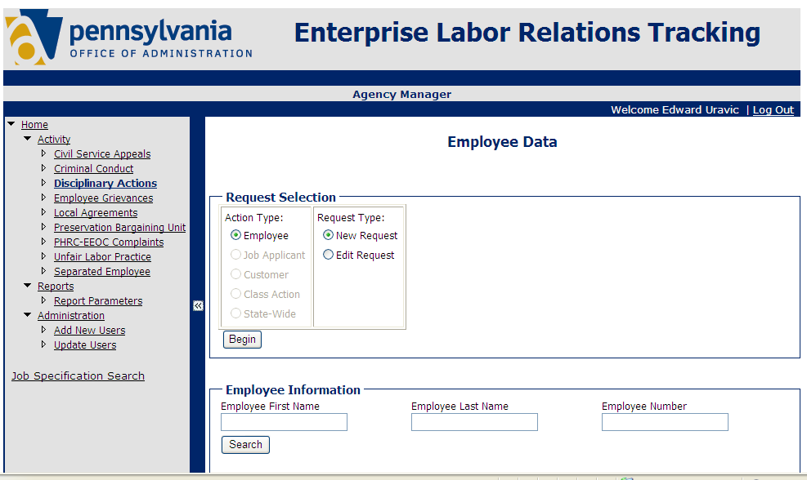
ELR Onboarding Guide Enterprise Labor Relations System

Slide 2
Objectives …for this onboarding session
Participants should be able to input and edit employee records in the ELR;
understand the security roles in the system and how they limit what individual LRCs can see and do;
and become familiar with the issues involved with implementing the ELR in an agency.

Slide 3
Why ELR?
Help agencies better track LR work
Improve reporting to agency and enterprise executives
Protect sensitive agency and enterprise data
Standardize on best practices for business and technology
Reduce paperwork for analysts

Slide 4
Let’s take a tour… Log in from the OA/BLR web page
Web page
Go to ELR
Guides
Log in first

Slide 5
Let’s take a tour… Log in to the ELR
Use CWOPA username and password
euravic
password
After you log in to the portal first, you will automatically stay logged in to the ELR

Slide 6
Let’s take a tour… Read and input data
Role
User
Activity
Exit
Activities
Request
Reports
Admin
Search
Navigation bar

Slide 7
Roles – Who Sees What Agency Manager
The agency’s first AM must be added by OA/BLR
AMs can then add, update and delete other AMs and Agency Professionals (AP)
You can assign an AP to specific org codes in your agency and to specific activities
You can see only employee records and users from your agency
You can see all activities
Handout: User Guide

Slide 8
Roles – Who Sees What Agency Professional
You can see only the activities assigned by your Agency Manager
You can see only employee records from your agency org codes assigned by your AM
You cannot add or update users
Handout: User Guide

Slide 9
Roles – Who Sees What Enterprise Managers and Professionals in OA/BLR
An enterprise manager
Can view and update all employee records in all activities
Can add, update and delete users for any agency
Can add items to some drop down lists
Can add and update agency managers
Cannot add or update agency professionals
An enterprise professional
Can only view reports for any employee in any agency

Slide 10
Instructor Demo Find and edit employee records
Handout: Form Fields/Reference Lists

Slide 11
Instructor Demo Find a separated employee and create a new record

Slide 12
Instructor Demo Download a report

Slide 13
Instructor Demo Add a new user

Slide 14
Instructor Demo Update a user

Slide 15
Input your own records
Log in to the ELR (www.elr.state.pa.us)
Pick an activity
Find an employee
Complete the form
Save the record
Repeat 1 thru 5
Add and/or update users
Download reports

Slide 16
ELR Onboarding How to Implement the ELR in Your Agency

Slide 17
ELR Onboarding Error Reporting

Slide 18
ELR Onboarding How an agency can implement the ELR
ELR Agency Manager identifies potential business issues
Compliance with OA policies
Changes in business processes
Identify the activities to input
We recommend using all the activities
Consider implementing them in sequential order
Review the roles and activities for each user
Consider how you might provide help and support beyond help from OA
Identify and address potential technical issues, if any
Determine approach (particularly for larger agencies)
One organization at a time
Pilot followed by full implementation
Central office followed by other offices
Determine training needs
Schedule the implementation

Slide 19
ELR Onboarding

